Slide 1
Engaging with the Committee on the Elimination of Racial Discrimination 2024

Slide 2
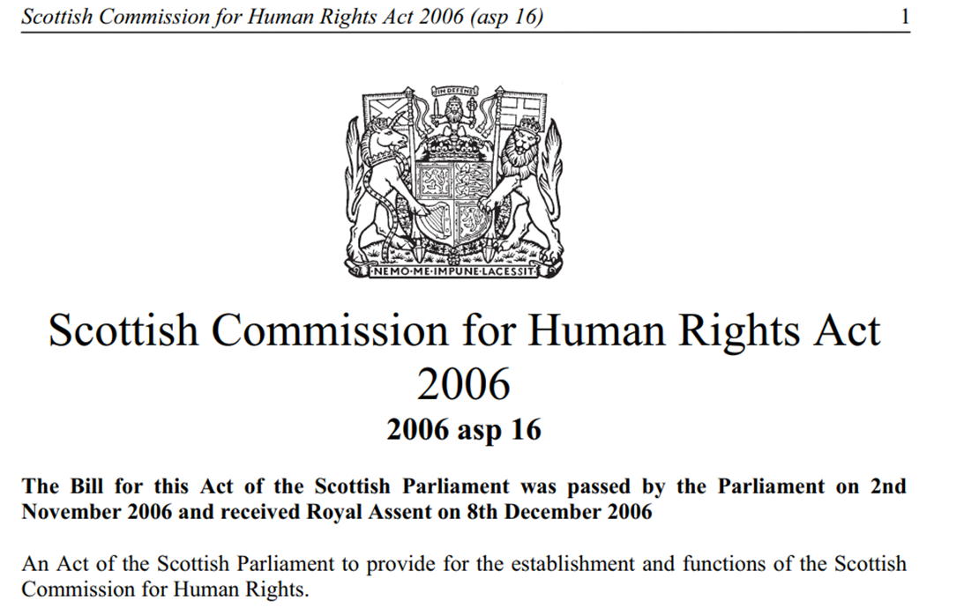
Introduction to the SHRC
Promotion
Monitoring
Accountability
Notes:
The Scottish Human Rights Commission (the Commission) is Scotland’s human rights watchdog. We are an independent, expert body that works with and for the people of Scotland; we monitor, listen, speak up for all our rights and respond when things go wrong. We are a public body created by the Scottish Commission for Human Rights Act 2006 to protect and promote the human rights of all people in Scotland’

Slide 3
Role of the Scottish Human Rights Commission
General Duty to Promote Rights
(Some) Powers to Protect
Obligation to cooperate with the United Nations and Council of Europe
Must be Independent and Pluralistic and work with others
Support Parliamentarians as Guarantors of Rights (Belgrade Principles.)

Slide 4
International Treaty Monitoring Cycle (CERD)
Interactive dialogue
NHRIS and NGOs promote implementation of COs
NGOs and NHRIs report
CERD sends List of Themes
NGOs and NHRIs report
Private Briefing
Make Recommendations – Concluding Observations
Notes:
N.b. All TBs have their own rules of procedure and timescales. Efforts to introduce a predictable review have been ongoing for some years.
Some treaties have adopted a simplified reporting procedure, which changes the ways states report to the committee. The State has to accept (through affirmation or rejection) a move to the SRP, which can mean different states using different processes for the same TB. Processes for NHRIs and NGOs are largely unaffected, but it changes the level of information we have from the state.
CoE treaty reporting is typically less standardised and often includes delegation visits to the state.

Slide 5
Process to Date
List of Issues Letter May 2024
Civil Society Engagement
Shadow Report
Private Briefing at the Committee
Speak at the Committee’s meeting with the Government
Sharing the Findings

Slide 6
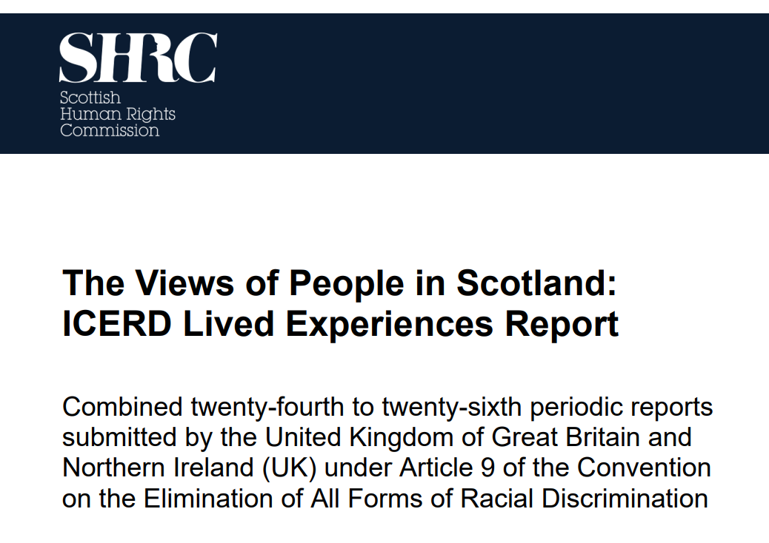
Civil Society Engagement
Small grants available to BEMIS and CEMVO
Four meetings
Attended by 76 people
SHRC presence (listening) but independent findings
Aware that this is a small number of people affected by racism – used as one source of evidence
Notes:
The Views of People in Scotland: ICERD Lived Experience Report (scottishhumanrights.com)

Slide 7
Interactive Dialogue August 2024
Committee of Experts
Informal Meeting with NHRIs Friday 9th August)
Informal Meeting with NGOs Monday 13th
Government Evidence over two days
Concluding Observations

Slide 8
What happens next?
Concluding Observations are not binding BUT states have accepted the authority of the Committee to make them
They carry independent, expert and authority based on international treaties
Civil society can use them to advocate for change
More formalised responses from the Government to support monitoring of progress

Slide 9
Why should we care about treaty monitoring?
Monitoring and the work of Treaty Bodies develops guidance on how we interpret and apply human rights globally
Deters and prevents violations by keeping Governments regularly and measurable accountable for their choices
Acts as an early warning system for acute violations and other forms of accountability e.g. court cases

